Slide 1
Synthetic Data Generation for
Recommendation Improvements:
A Mixed Bayesian Approach
The Bayesian Explorers
7/29/21
Notes:
Better name for presentation?
Still need group name

Slide 2
Outline
Introduce team members/mentors (need to come up with team name)
Background:
Mention problem, goal, and benefit to company
Zipzones (map??)
Current models (all Z3->Z3):
Diagram (overall process of generating data - 2 parts)
Best fit distributions for independent columns:
Show some examples (superimpose original and generated)
Hierarchical model:
Describe math behind model
Show either rate or cost generated data and original data
BBN:
Describe math behind model
Show some statistics on how it’s performing
Pictures?
Route ahead:
Expanding to other zipzones
Play with structure of graph (other dependencies?)
Testing our model

Slide 3
Project Collaborators
Team Members:
Muharrem Baris Otus
Samanwita Samal
Lauren Snider
Sijie Tang
Miao Zhang
Ahmed Zytoon
Mentors from C.H. Robinson:
Natalie Heer, Senior Data Scientist
Michael Chmutov, Data Scientist
Bethany Stai, Data Scientist
Mentors from IMA:
Daniel Spirn
Thomas Höft

Slide 4
Content
Problem and goal
Modeling and results
Bayesian Hierarchical Model
Bayesian Belief Network
Future directions

Slide 5

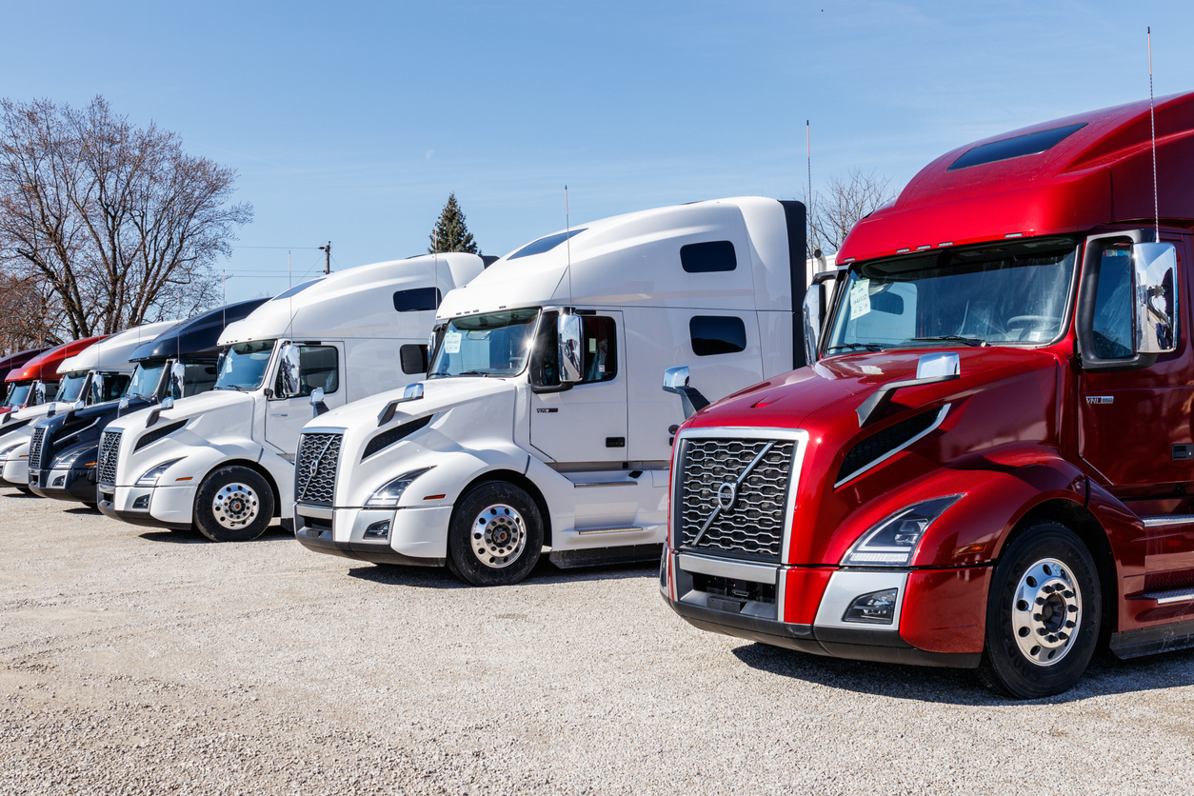




To Accept or Reject?

Slide 6
C.H. Robinson’s Order Decision Process
Recommender
System
Yellow or Red
Account Team
Customer
(Shipper)
Places Order
Green
Acceptance
Rejection
CustomerWithdraws
Notes:
Some greens get rejected too right?

Slide 7
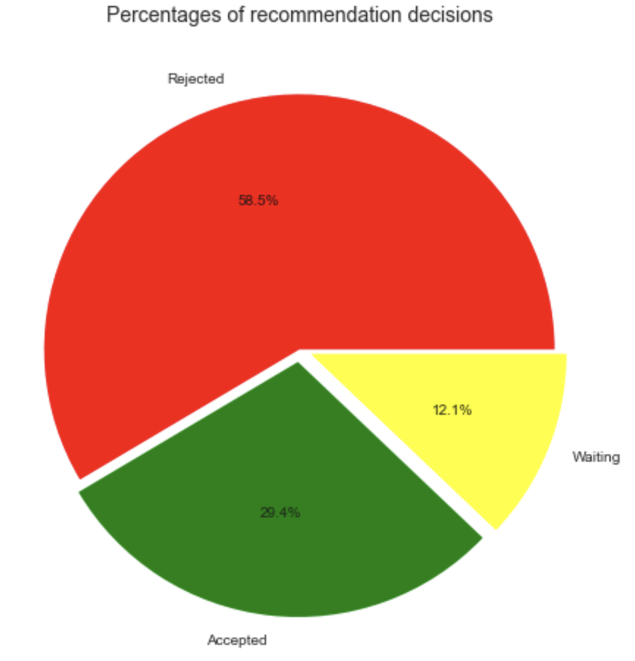
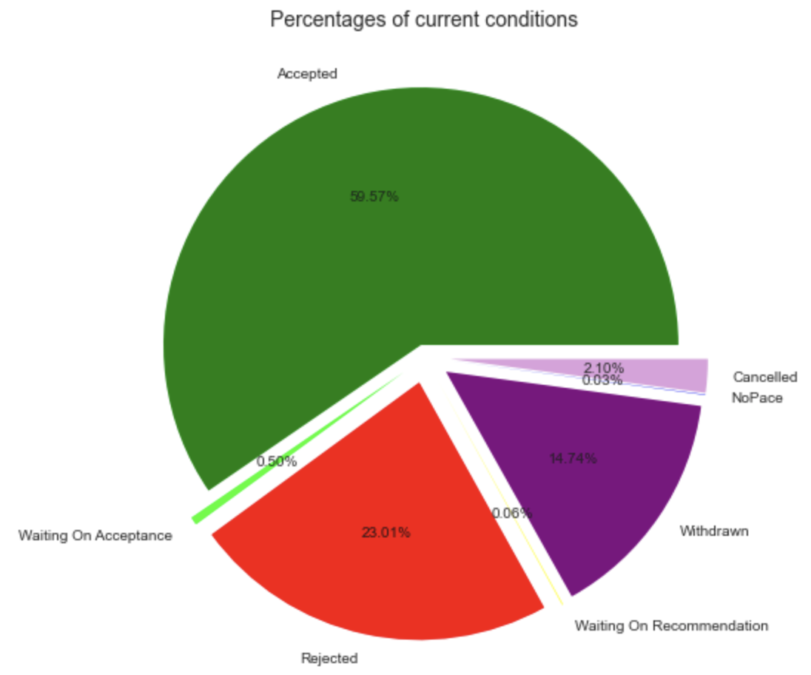
Decisions: Recommender Vs. Account Team

Slide 8
Problem
C.H. Robinson needs a platform on which to test improvements to their recommender system.
Proposed Solution
Use of Bayesian methods to produce a parametric model of the order decision process which generates synthetic data.
Impact on CHR
De-risk improvements to the recommender system and make order processing more efficient.
Notes:
Mention model needs to be explainable, that is why we choose Bayesian approach

Slide 9
Why Synthetic Data?
To achieve more robust improvements of the Recommender System
To avoid overfitting any improvements to the original data
To de-risk modifications to the Recommender System
Notes:
Three bullet
Captures interactions between decision factors
Decision outcomes are not independent of each other (e.g. limited supply of trucks)

Slide 10
A Quick Peek at Our Data
Transactional data on 161,563 orders sent to C.H. Robinson from certain weeks in March, May, and June of 2021
Data included information like order distance, truck type, weight of order, lead days, recommender outcome, origin and destination location indicators, normalized rate, normalized cost, and final outcome

Slide 11
Our Three Layer Generative Model
Independent columns are generated by fitting the best distribution to that column
Order Information
(order_origin_weight, order_distance, order_num_stops, order_equipment_type)
Time
(lead_days,
weekday, week_id)
Rate
(rate_norm)
Estimated Cost
(est_cost_norm)
Recommender Outcome
(color)
Final Decision
(CurrentCondition)
Notes:
Need to add slide title
Generative models for each layer? Ways to generate different columns?
Other Idea: A Three Step (or Layer?) Generative Model

Slide 12
Our Three Layer Generative Model
Order Information
(order_origin_weight, order_distance, order_num_stops, order_equipment_type)
Time
(lead_days,
weekday, week_id)
Best-fit distribution
Rate and estimated cost are generated by Bayesian Hierarchical Modeling
Rate
(rate_norm)
Estimated Cost
(est_cost_norm)
Recommender Outcome
(color)
Final Decision
(CurrentCondition)
Notes:
Slide needs title

Slide 13
Our Three Layer Generative Model
Order Information
(order_origin_weight, order_distance, order_num_stops, order_equipment_type)
Time
(lead_days,
weekday,
week_id)
Best-fit distribution
Bayesian Hierarchical Modeling
Rate
(rate_norm)
Estimated Cost
(est_cost_norm)
Recommender Outcome and Final Decision are generated by Bayesian Belief Network
Recommender Outcome
(color)
Final Decision
(CurrentCondition)
Notes:
Slide needs title

Slide 14
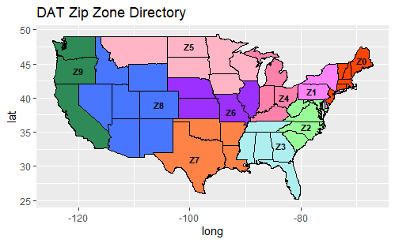
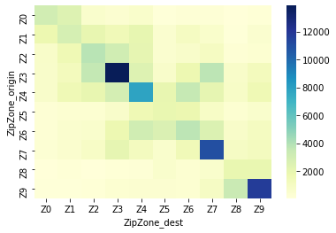
Order Volume by Zip Zone Pair?
Notes:
Our data consists of information from 161,563 orders, including location

Slide 15
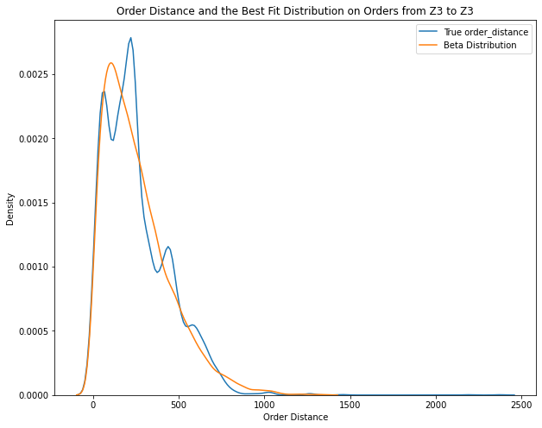
Fitting Distributions to Continuous Independent Columns
Continuous Columns:
order_origin_weight
order_distance
Order_distance ~ Beta(α=1.617, β=14.258)
From Z3 to Z3
KS-test result:
Statistic = 0.0354, p-value = 7.246e-15
Notes:
We can also add the formula for beta distribution?
What does KS test mean?

Slide 16
Fitting Distributions to Continuous Independent Columns
Continuous Columns:
order weight
order distance
Plot shows all 13,270 orders
from Z3 to Z3 in our data.
Order_distance ~ Beta(α=1.617, β=14.258)
Notes:
We can also add the formula for beta distribution?
What does KS test mean?

Slide 17
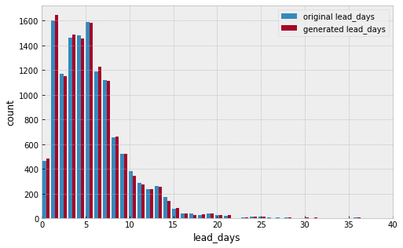
Multinomial Distribution to Discrete Independent Columns
Discrete Columns:
lead days
week ID
number of order stops
Notes:
Need to tell what a multinomial distribution is?

Slide 18
Bayesian Hierarchical Model
Bayes’ Theorem:
P(B|A)P(A)
P(A|B) =
P(B)
Bayesian:
This model takes into account the uncertainty in the observed data (by updating the priors) and computes the corresponding uncertainty in the predicted data (posterior) in an iterative process using Bayes’ Theorem.
Hierarchical:
This method has multiple levels (hierarchy) of priors which helps to capture the variability or commonality between different variables.
Notes:
Parameters = priors and hyperpriors
P(A|B) = posterior, P(A) = prior, P(B|A) = likelihood, P(B) = marginal

Slide 19
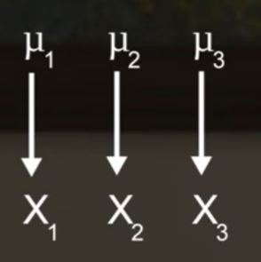
Example (standardized test scores)
Consider a study in which students’ scores of a standardized test such as the SAT are collected from three different schools. Suppose we are interested in learning about the mean SAT score and estimating the relative performance of each school or predicting the SAT score for a new student in a particular school. There are 3 approaches:
Unpooled model (Separate estimates)
Finding a separate mean SAT score for each school

Slide 20
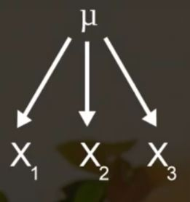
Example (standardized test scores)
Consider a study in which students’ scores of a standardized test such as the SAT are collected from three different schools. Suppose we are interested in learning about the mean SAT score and estimating the relative performance of each school or predicting the SAT score for a new student in a particular school. There are 3 approaches:
Pooled model (Combined estimates)
Finding a common mean SAT score taking the scores from all schools together

Slide 21
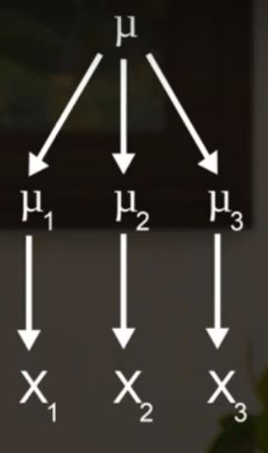
Example (standardized test scores)
Consider a study in which students’ scores of a standardized test such as the SAT are collected from three different schools. Suppose we are interested in learning about the mean SAT score and estimating the relative performance of each school or predicting the SAT score for a new student in a particular school. There are 3 approaches:
Hierarchical model (A two-stage prior leading to compromise estimates)
Finding a new mean (posterior) for each school that also takes into account the variation among the original means (prior) across schools

Slide 22
Outline for hierarchical part:
Slide with description (example of Bayes’ Theorem, explain what a hierarchical model is, etc)
Unpooled model
Explain what makes this model ‘unpooled’
Are there any pictures we can show?
Partially pooled model
Explain what makes this model ‘partially pooled’
Pic of flowchart generated from graphviz
At least one pic of distribution - could even show both rate and cost?
Trace plots to compare with unpooled model

Slide 23
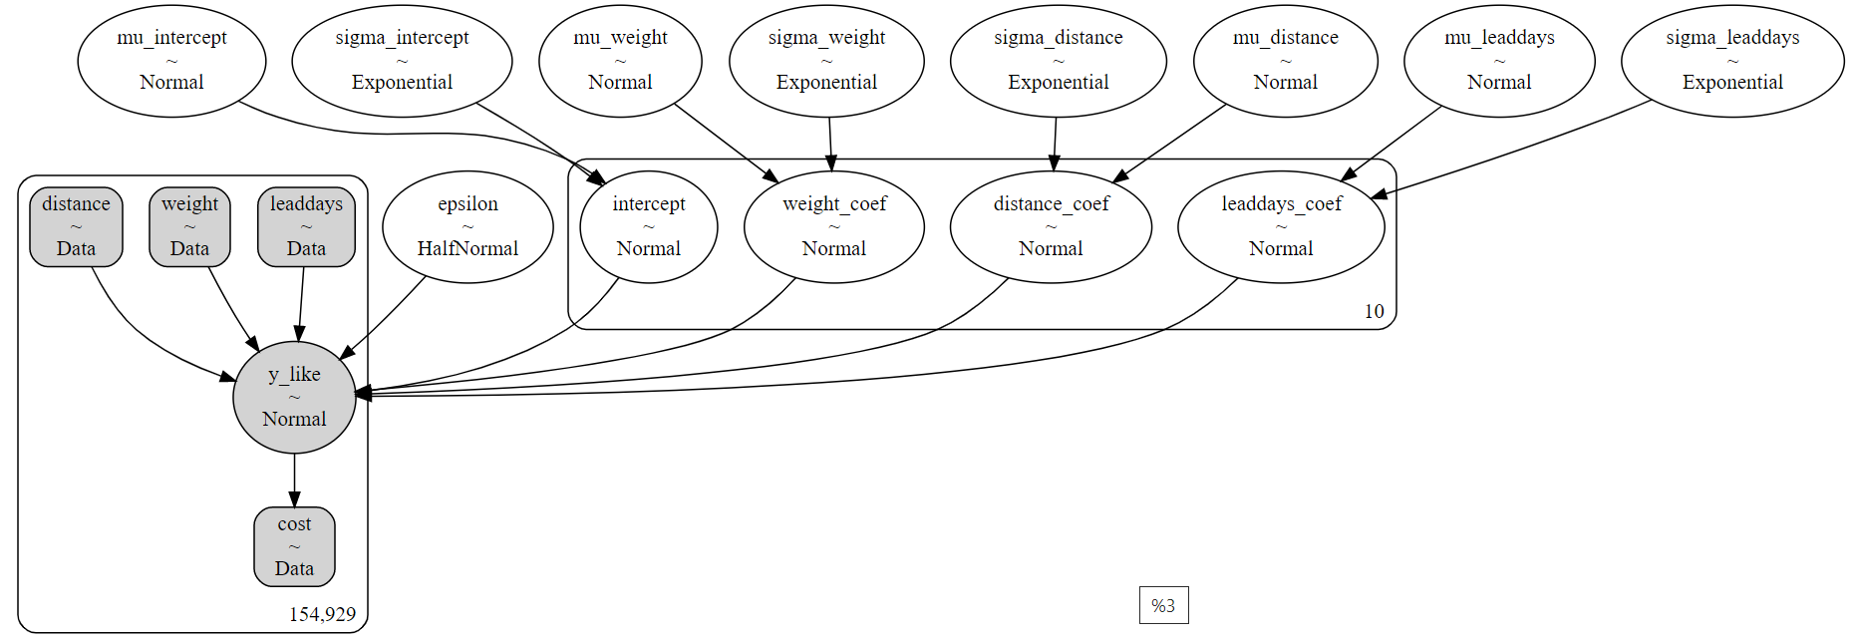
Our Partially Pooled Model of Cost
Notes:
Mention how mu of y_like is linear regression that’s indexed by ZipZone_origin

Slide 24
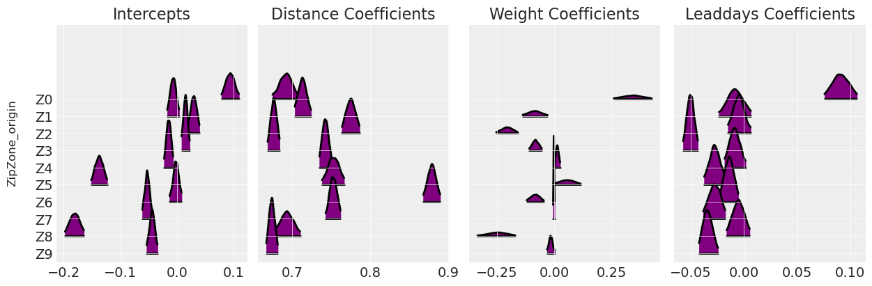
Traces of the Coefficients in Our Model
?
Notes:
Add the regression equation too? (Strongly agree to this since it’s a technical presentation)

Slide 25
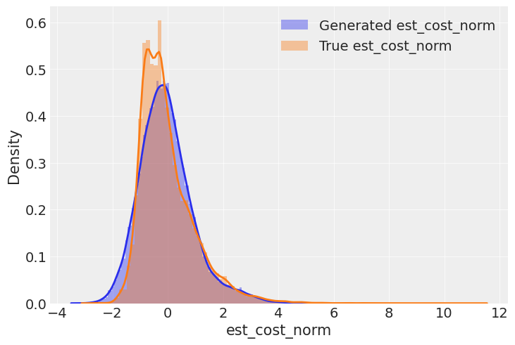
Is Our Model Generating Realistic Cost Data?
Notes:
Kernel Density Estimation plot
Future: Need some non visual measure of accuracy of predicted est_cost_norm

Slide 26
Why Bayesian Belief Network As The Third Layer?
Not able to use Bayesian Hierarchical Model to generate discrete variables
BBN is good for generating discrete variables out of discrete variables
BBN can show the probabilities or conditional probabilities for all nodes

Slide 27
Bayesian Belief Network (BBN)
Probabilistic graphical model
Specifies which variables are dependent, independent, or conditionally independent
Tracks in real-time how each event's probabilities change as new evidence is introduced to the model

Slide 28
Simple BBN for Recommender and Final Outcomes
Rate
(rate_norm)
Estimated Cost
(est_cost_norm)
Recommender Outcome
(color)
Final Decision
(CurrentCondition)
Notes:
Each random variable is a node
BBN is good in generating discrete variables out of discrete variables.

Slide 29
Simple BBN for Generating Recommender Outcomes
Rate
(rate_norm)
Estimated Cost
(est_cost_norm)
cost | ≤ -2 | ≤ 0 | ≤ 2 | ≤ 4
P
rate | ≤ -2 | ≤ 0 | ≤ 2 | ≤ 4
P
Recommender Outcome
(color)
Categories color | GREEN | RED | YELLOW
rate ≤ -2 & cost ≤ -2
rate ≤ -2 & cost ≤ 0
…
rate ≤ 4 & cost ≤ 4

Slide 30
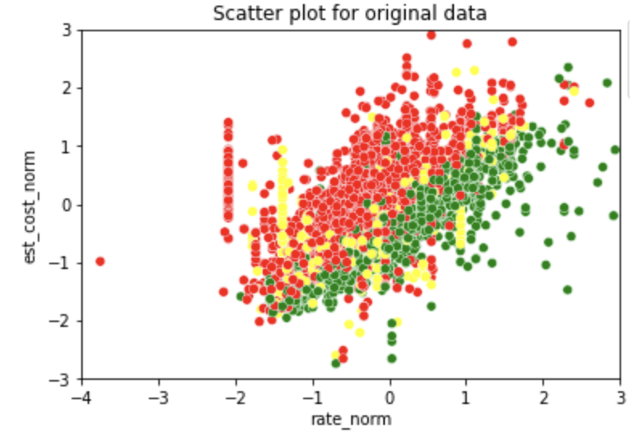
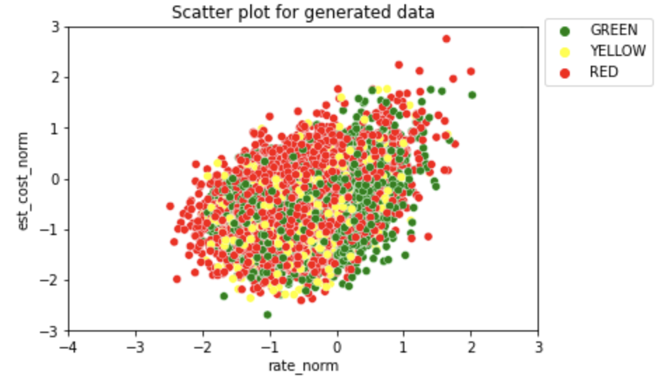
BBN Results for Recommender Decisions
The colors in generated data have a similar distribution to that in the original data
The generated data excludes outliers

Slide 31
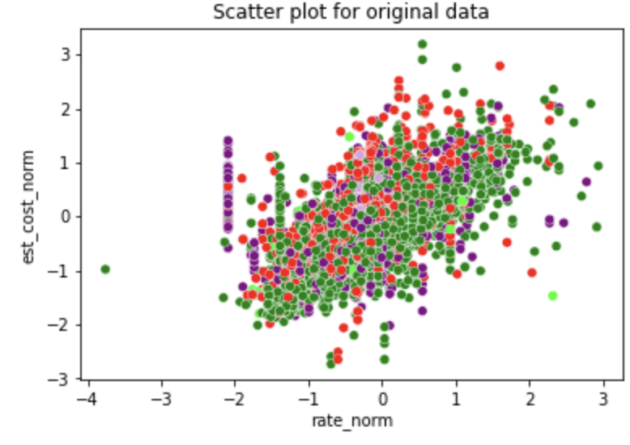
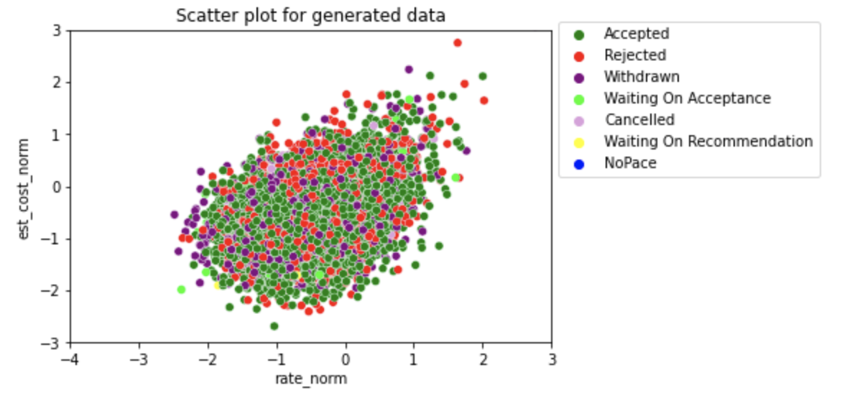
BBN Results for Current Conditions
The distribution of current conditions in the generated data is very close to the distribution in the original data
The generated data excludes outliers

Slide 32
Why Use the K-prototype Algorithm ?
The cost function in K-Means is calculated using the Euclidean distance that is only suitable for numerical data
K-Mode is only suitable for categorical data
The K-Prototype algorithm was created in order to handle clustering algorithms with the mixed data types (numerical and categorical variables)
Notes:
We do some clustering of data that contained both continuous, discrete and categorical features

Slide 33
The Results of K-prototype Clustering for original and generated data
 | original_data | generated_data
Num_K | 13,756 | 12,228
P_K | 0.53 | 0.47
Original_data in Z3-Z3:
12,992
Generated_data in Z3-Z3:
12,992
Notes:
What we did
Ratio means
Conclusion
Lead_days can be continuous variable, now in our model is categorical data
Don’t need to transfer our data

Slide 34
Improvement and Evaluation of Model
Consider other zip zone pairs, like Z9 to Z9 and Z7 to Z7
Use more independent columns (week_id, weekdays, order_num_stops and order_equipment_type) and account for possible covariance
“Break apart” some multimodal distributions as a combination of several distributions
Make the hierarchical model and BBN iterative, taking posteriors as priors in next iteration
Use statistical tests like the Kolmogorov-Smirnov test (KS test) and Bayesian information criterion (BIC) to test the model
Notes:
“Break apart” some multimodal distributions as a combination of several distributions
Add other zipzones
Use more independent columns
Account for covariance in independent columns
Methods to test model (need to look at links that Natalie sent Friday) Kolmogorov–Smirnov test and Bayesian information criterion
For hierarchical and BBN, taking posteriors as priors in next iteration

Slide 35
Summary
We use 3-layers of data generation methods to build our model:
Best fit distributions to generate independent columns
Bayesian Hierarchical Modeling to generate normalised rate and cost variables
Bayesian Belief Network to generate recommender color and current conditions
We test the generated data by implementing the K-prototype method.

Slide 36
Work in progress
Incorporating covariance matrix in our hierarchical model to account for covariance between independent columns
Indexing our generated coefficients using zipzones as a way to look up generated data for a particular zipzone
Adding time information into our model

Slide 37
Future Plan
Since our model consists of 3 layers, there is a room to improve each layer individually :
Hierarchical modeling can be used to generate the independent columns in place of best fit distributions and with a larger number of iterations we can achieve higher accuracy
Fine tuning the categories for the continuous variables in the Bayesian Belief Network (BBN) can give us better estimates
Adding more nodes and factoring in dependency from the independent variables like the time and location variables can lead to a more comprehensive BBN model
The results from K-prototype algorithm can be more accurate by adding more columns from the original data set and the generated dataset.

Slide 38
Python Packages Used in Implementation
SciPy.stats: best fit distributions
PyMC3: Bayesian hierarchical model
PyBBN: Bayesian belief network
kmodes.kprototypes: K-prototype algorithm

Slide 39
Thank you.

